Slide 1
FINAL PROJECT PROG8470 MOBILE APP DEVELOPMENT
COVID-19 Global data and awareness application

Slide 2
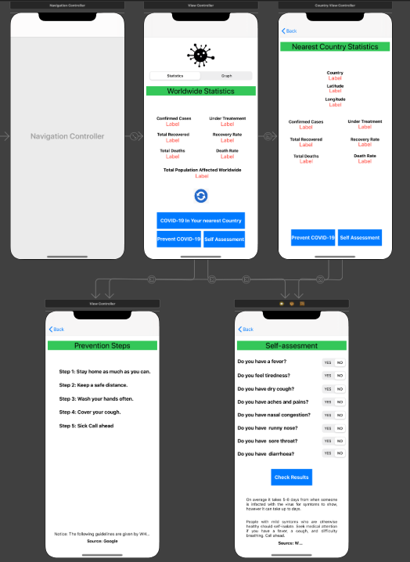
STORYBOARD
Screen Navigation:
Worldwide Statistics and Graph of COVID-19
Nearest Country Statistics of COVID-19
Prevention Steps from COVID-19
Self-assessment for COVID-19

Slide 3
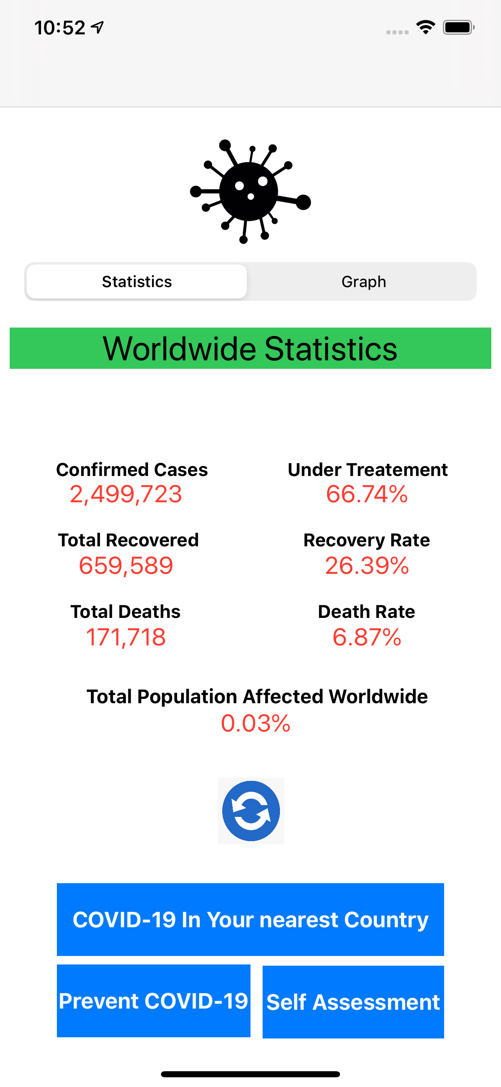
Worldwide statistics and graph
Worldwide statistics:
Total cases, total recovered & total deaths.
Percentage of people under treatment, recovery rate and death rate.
Percentage of people affected around the world.
Segment Control tab:
Used to switch between numeric data and graphical data.

Slide 4
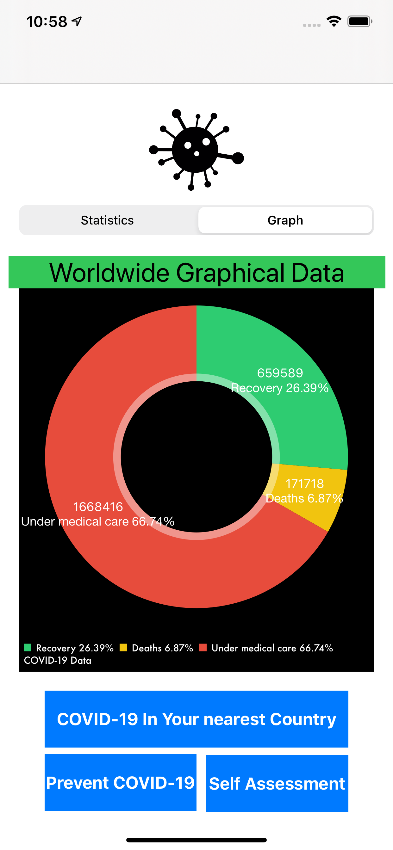
Worldwide statistics and graph
Worldwide Graphical data:
Pie chart
Reflects the percentage share of people under treatment, died and recovered from the total affected by COVID-19.
Legend to map color with a corresponding data.
Check COVID-19 data in a nearest country:
Button added to check the data in a country nearest from your current location.

Slide 5
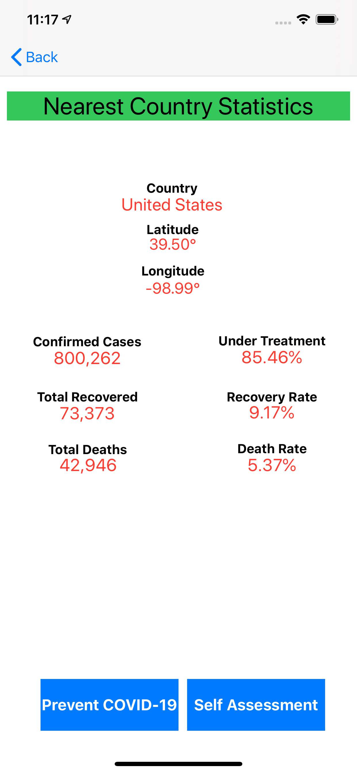
Nearest country Statistics
Nearest Country Statistics
Country name
Latitude and longitude
Total confirmed cases (counts)
People recovered (counts + percentage)
People died (counts + percentage)
People still under treatment (percentage)

Slide 6
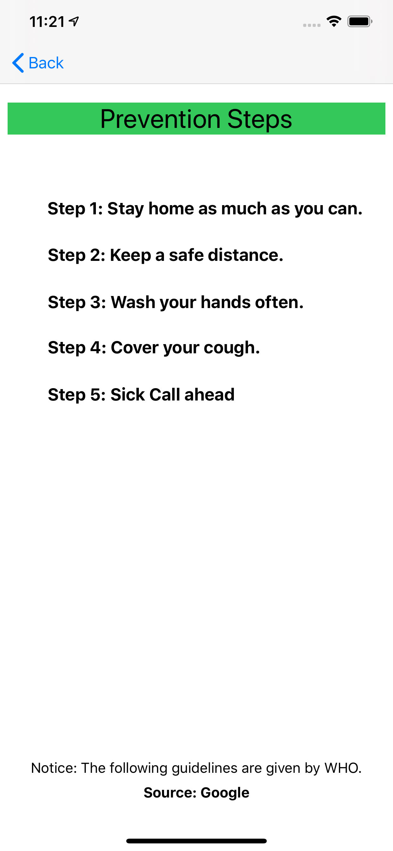
PREVENTION STEPS
Prevention Steps against COVID-19
Recommended by WHO to avoid infections.
Source: google

Slide 7
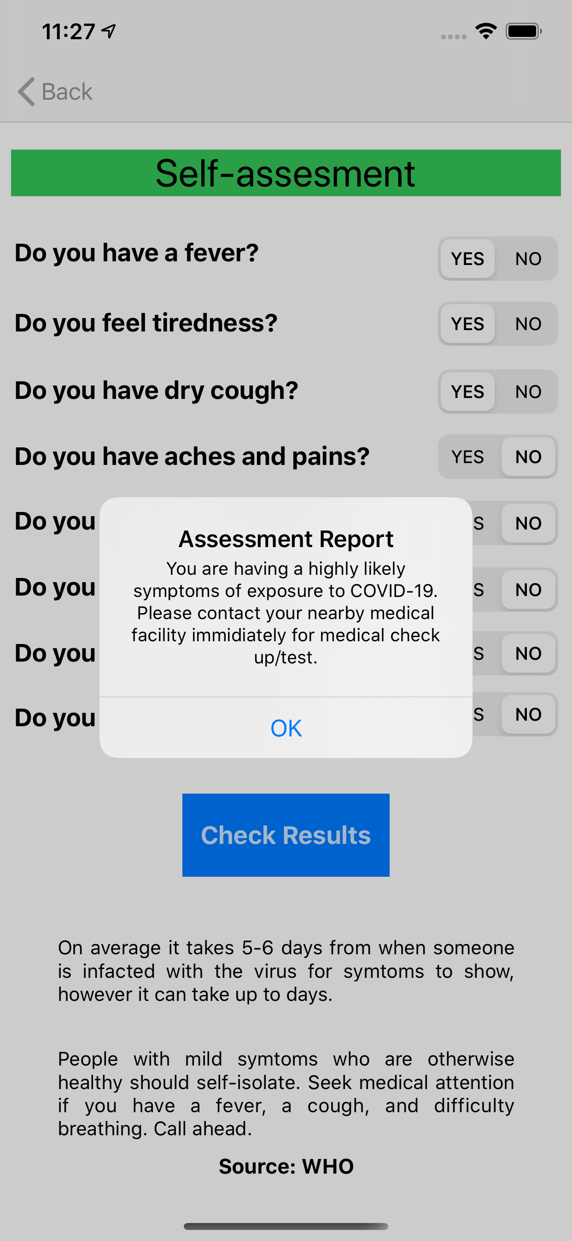
SELF-ASSESSMENT
Self-assessment for COVID-19
Recommended by WHO to avoid infections.
Source: WHO
List of questions need to answer in YES/NO.
Once all answers selected, check the assess report.

Slide 8
App KEY Features
Pie-chart
Segment control to switch between views (Additional feature)
UIAlertView
Location access
Well–formatted and processed data
Easy to use UI

Slide 9
Thank You!
Any Questions?

